Slide 1

CS4225/CS5425 Big Data Systems for Data Science
Exam
Ai Xin
School of Computing
National University of Singapore
aixin@comp.nus.edu.sg

Slide 2
Exam
Date: Nov 29, Wednesday
Time: 13:00pm – 15:00pm
Students are allowed to enter the venue at 12:50pm
Students will not be permitted to enter the venue after 14:00pm
Venue: MPSH2-A
NUS Multipurpose Sports Hall 2 (MPSH2)
F2F - Hardcopy (pen and paper)
Open Book Exam
Any physical materials are allowed
Calculator is allowed
Any other electronics devices are NOT allowed

Slide 3
Exam
Focus is on understanding and application, not facts / memorization
Question structures (total 50 marks):
Ture / False question with a short explanation / justification
Application / Scenario Based Question
Give you a practical scenario and let you come out a solution / suggestion
Example questions
Integrative: Require you to combine knowledge from different weeks of content
“Application”: Require you to apply your knowledge of fundamental concepts to reasonably practical scenarios.
“Why not”: Example, Tommy proposed a solution A to solve problem B. Tell me what is the problem with solution A and how to overcome this problem

Slide 4
Scope of Exam
Scope: the content in the lectures (1-10) and tutorials(1-5)
Out of scope:
The content marked as “optional” or in the appendix
Additional information in the comment box
Some notes in the comment box is explaining / clarifying the content in the slides, which is not additional information.
In the following, I will
Have a revision on the key points that we learnt after recess week.

Slide 5
Spark I
Introduction
In memory processing and easy to use
Driver and Executors
RDD
Distributed, Immutable, Lazy Transformations, Action to trigger the computation
Caching an RDD: when it is expensive to compute and needs to be re-used many times
DAGs
The lineage of an RDD, Within Stage (Narrow Transformation), Across Stage (Wide Transformation)
DataFrame: the recommended interface
filter, sort, join, groupby, and etc.
Datasets: type-safe during compile time

Slide 6
Spark II
Spark SQL and Catalyst Optimizer
Unifies Spark components and permit various languages
Tell Spark what to do and then Spark will generate an optimized plan
Machine Learning Pipeline
Pre-process the Data
Build the model using Training Data
Evaluate the Model using Testing Data
Implementing ML Pipeline using Spark Mllib
Transformer
transform() method: map df1 to df2
Estimator
fit() method: takes in data and outputs a fitted model (“transformer”)
Model training stage: iterative distributed in-memory computation
Cache training data in memory across iterations
Use broadcast variable to save & broadcast weights iteration by iteration

Slide 7
Stream
Spark: Structured Streaming (latency of a few seconds)
Micro-Batch approach, Incremental Execution
Five Steps to define a streaming query
Stateless Transformation: filter(), map(), etc.
Stateful Transformation / Aggregation
Not Based on Time: groupBy().count()
Based on Time:
Event time vs. Processing time,
Tumbling Windows, Overlapping / Sliding Windows
Watermark: handling late data
Flink: Real-time streaming processing (latency of milliseconds)
a distributed system for stateful parallel data stream processing
Event time processing with watermarks
State Management: distributed snapshots using checkpoint barriers

Slide 8
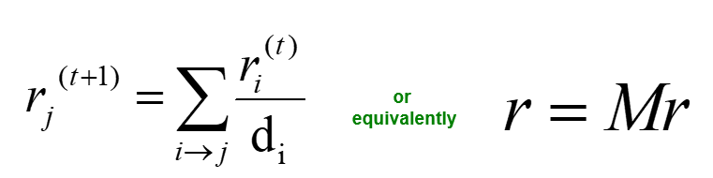
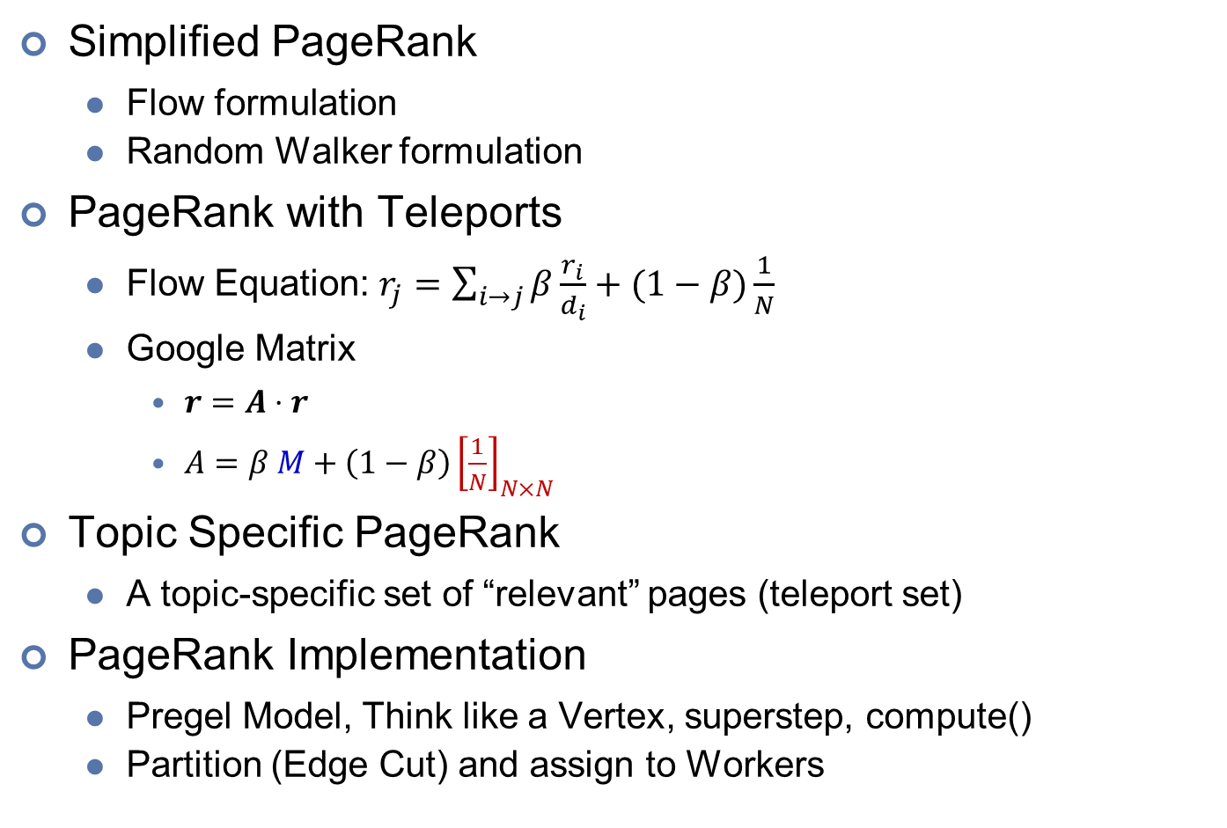
Graph
Simplified PageRank
Flow formulation
Random Walker formulation
PageRank with Teleports
Flow Equation: $r_{j}=\sum_{i→j}{β\frac{r_{i}}{d_{i}}}+(1−β)\frac{1}{N}$
Google Matrix
$r=A⋅r$
$A=β M+\left(1−β\right){\left[\frac{1}{N}\right]}_{N×N}$
Topic Specific PageRank
A topic-specific set of “relevant” pages (teleport set)
PageRank Implementation
Pregel Model, Think like a Vertex, superstep, compute()
Partition (Edge Cut) and assign to Workers

Slide 9
Evolution of Data Architectures
Relational Database
strong transactional ACID guarantees
Data Warehouses
a central relational repository, ACID guarantees
Data Lake
A distributed storage solution, runs on commodity hardware and easily scales out horizontally
Decouples the distributed storage and computing
Mostly cannot provide ACID guarantees, lack of schema enforcement
Lakehouses: data lake + data warehouse
Flexible, low cost, scale + ACID transactions
Delta Lake solution: DeltaLog (a single source of truth).

